Slide 1
Module 21

Slide 2

AREAS RELATED
TO CIRCLE
Sums based on Area of sector
Notes:
School
2

Slide 3
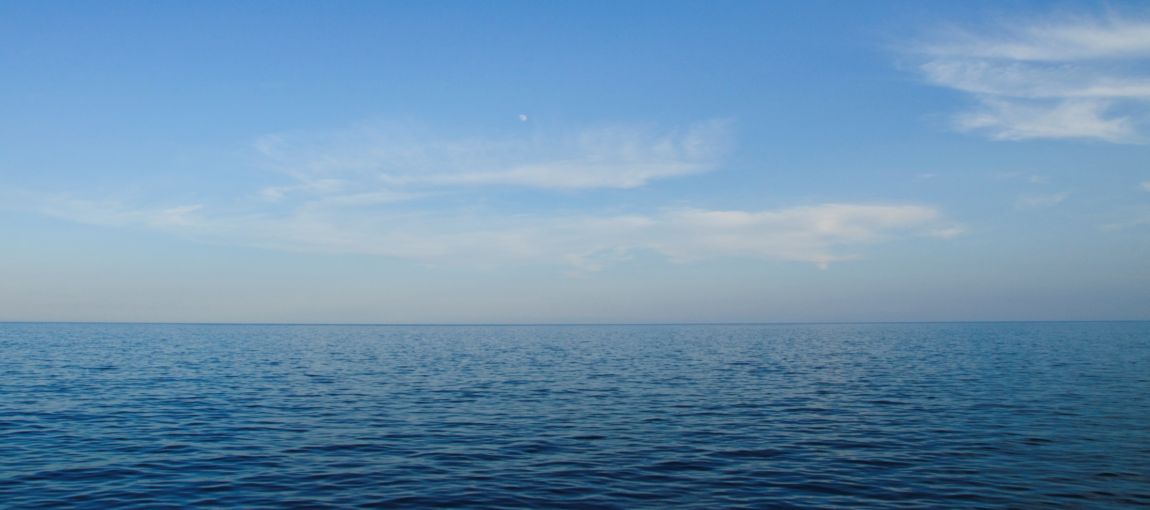

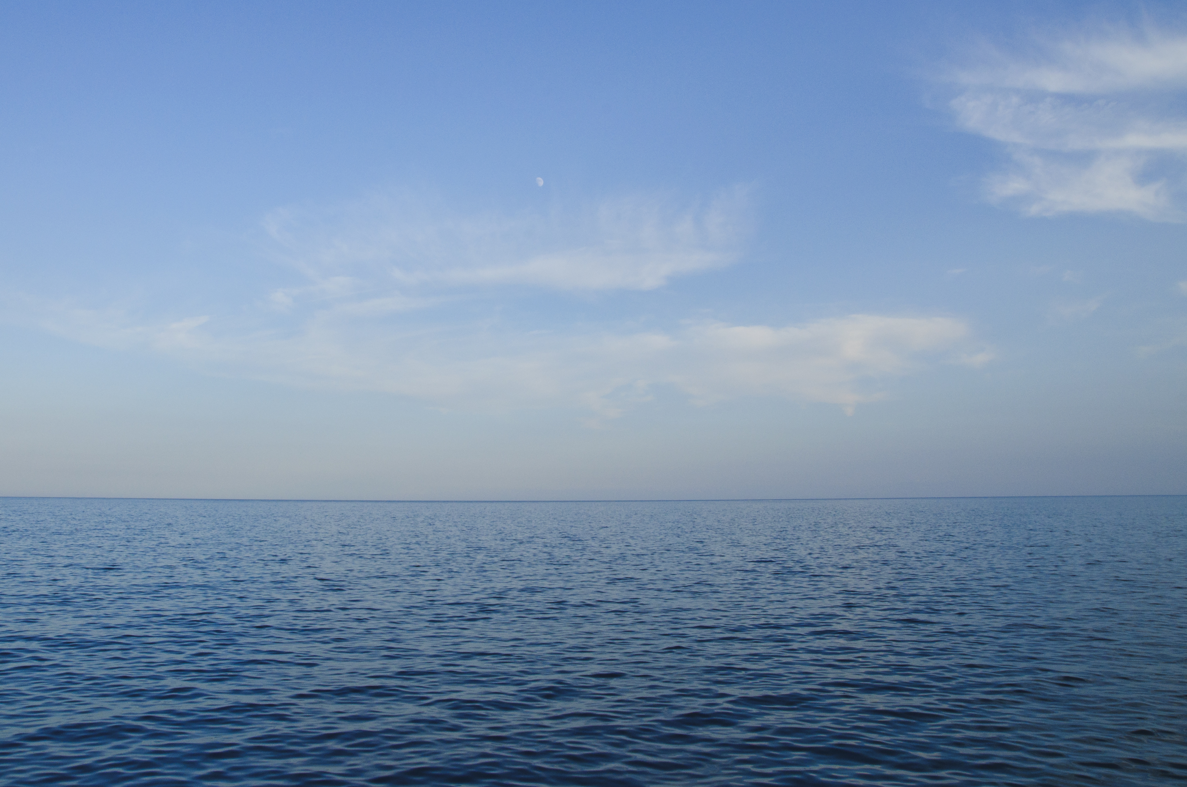
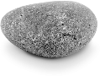
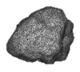

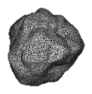

To warn ships for underwater rocks, a lighthouse spreads
a red coloured light over a sector of angle 80°
to a distance of 16.5 km.
Find the area of the sea over which the ships are warned. (Use π = 3.14)
80°
16.5km

Slide 4

To warn ships for underwater rocks, a lighthouse spreads
a red coloured light over a sector of angle 80°
to a distance of 16.5 km.
Find the area of the sea over which the ships are warned. (Use π = 3.14)
Sol.
Radius (r) = 16.5 km
O
Central angle (θ) = 80º
θ
16.5 km
80°
ar(O-AXB)
=
× πr²
360
2
80
=
3.14
16.5
× 16.5
×
×
360
9
55
55
B
A
314
165
2
165
=
×
×
×
✓
9
100
10
10
X
?
✓
3
1
?
θ
2 × 314 × 55 × 55
1899700
What is the formula to find area of sector?
=
$$×$$
πr²
=
360
10000
10000
=
189.97 km²
∴
Area of sector is 189.97 km²

Slide 5


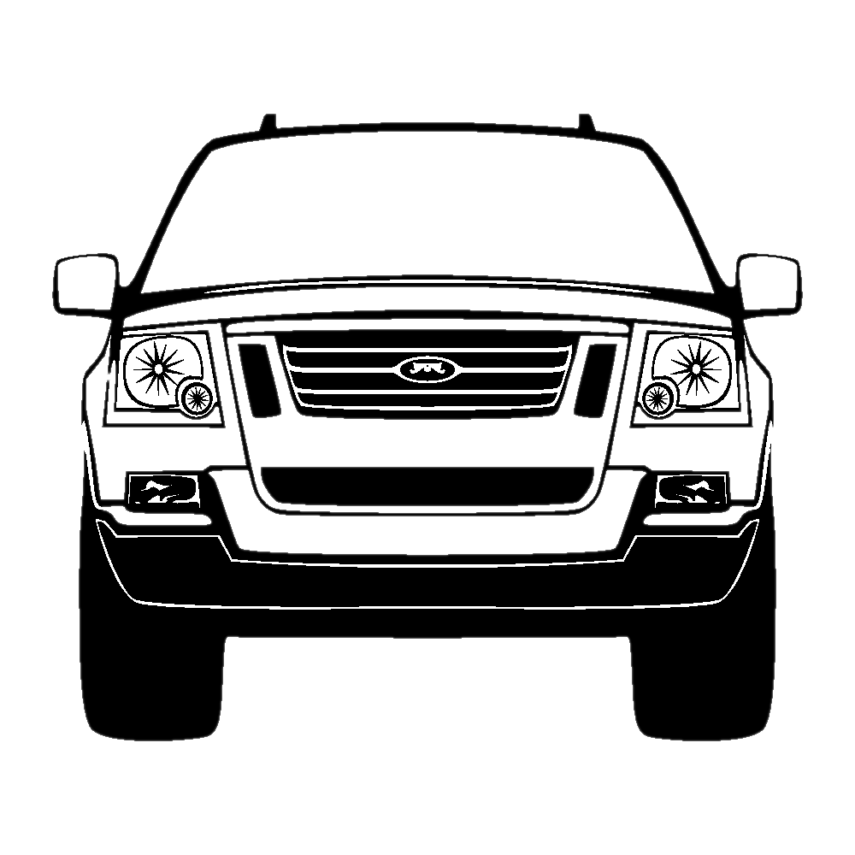
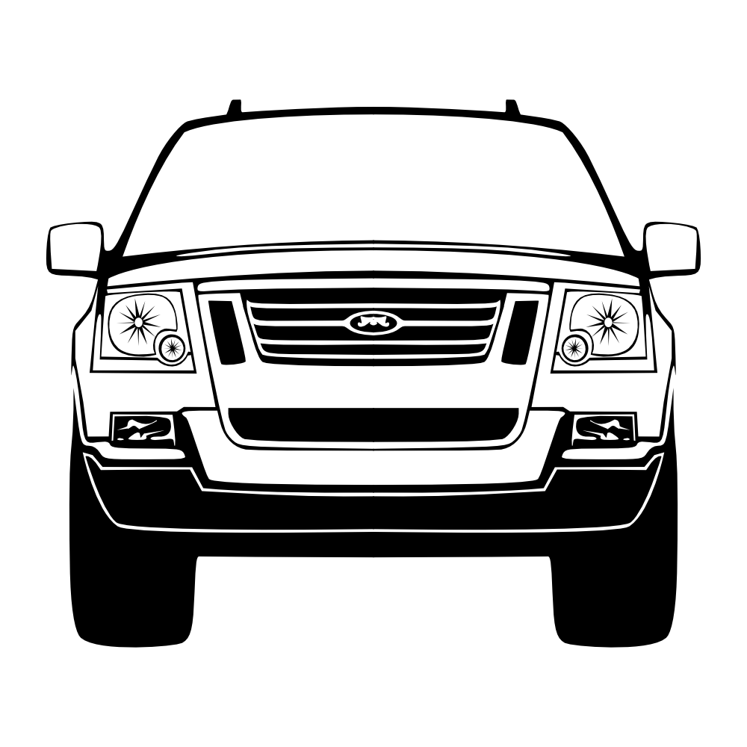
Q. A car has two wipers which do not overlap. Each wiper has a
blade of length 25 cm sweeping through an angle of 115°.
Find the total area cleaned at each sweep of the blades.
115º
115º
25 cm

Slide 6
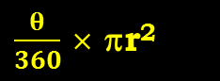
Q. A car has two wipers which do not overlap. Each wiper has a
blade of length 25 cm sweeping through an angle of 115°.
Find the total area cleaned at each sweep of the blades.
Sol.
r = 25 cm
X
θ = 115º
A
B
θ
∴
ar(O-AXB)
× πr²
115º
115º
=
360
25 cm
23
11
115
22
O
=
360
×
7
× 25
× 25
72
36
=
23
×
11
× 25
× 25
36
7
∴
Total area
23
11
=
2 ×
×
× 25
× 25
area of sector =
$\frac{θ}{360}$ × πr²
36
7
18
23
× 11
× 25
× 25
=
18 × 7
∴
The total area cleaned at each sweep
of the blades is
158125
1254.96
cm²
=
126
∴
Total area
=
1254.96
cm²

Slide 7
Module 22

Slide 8
AREAS RELATED
TO CIRCLE
Sum based on finding area of
shaded portion
Notes:
School
8

Slide 9


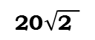
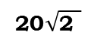
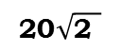



Q. In given figure, a square OABC is inscribed in a quadrant
OPBQ of a circle. If OA = 20 cm, find the area of the shaded region.
We know,
✓
?
Q
ar(O – PBQ)
ar(shaded region) =
– ar(◻OABC)
$$\sqrt{\text{2}}$$
×
Diagonal
Side
=
Sol.
OABC is a square
Draw OB
To find: r
∴
C
B
∠O
=
90°
Radius of quadrant =
Diagonal of a square
Diagonal
$$\sqrt{\text{2}}$$
=
×
∴
Side
✓
?
?
What is formula to find area of quadrant?
$$\sqrt{\text{2}}$$
$\frac{θ}{360}$ × πr²
So, to find radius we need to find diagonal of square.
=
×
20
Diagonal
$$\text{20}\sqrt{\text{2 }}$$
∴
=
cm
∴
Radius of quadrant =
$$\text{20}\sqrt{\text{2 }}$$
cm
P
Radius of quadrant =
Diagonal of a square
O
20 cm
A
θ
ar(O – PBQ) =
360
×
πr²
Let us draw radius for given quadrant OPBQ
90
5
=
×
$$\text{20}\sqrt{\text{2 }}$$
$$\text{20}\sqrt{\text{2 }}$$
×
×
360
3.14
4
=
3.14
×
5
×
20
×
We know,
2
OABC is a square
=
3.14
×
200
∴
ar( O – PBQ) =
628 cm²

Slide 10
Q. In given figure, a square OABC is inscribed in a quadrant
OPBQ of a circle. If OA = 20 cm, find the area of the shaded region.
✓
✓
?
Q
ar(shaded region) =
ar(O – PBQ)
– ar(◻OABC)
Sol.
What is formula to find area of square?
B
ar(◻OABC) =
(Side)²
(Side)²
C
=
(20)²
∴
ar(◻OABC) =
400 cm²
ar(O – PBQ)
ar(shaded region) =
– ar(◻OABC)
P
O
20 cm
A
=
628
–
400
∴ ar(shaded region) =
228 cm²
∴ ar(shaded region) is
228 cm²
ar(O – PBQ) =
228 cm²

Slide 11
Module 23

Slide 12
AREAS RELATED
TO CIRCLE
Sum based on finding area of
shaded portion
Notes:
School
12

Slide 13
Q. In the figure, ABCD is a square of side 14 cm.
with centres A, B, C and D, four circles are drawn such that each circle
touch externally two of the remaining three circles.
Find the area of the shaded region.
✓
ar (shaded region) =
ar (◻ ABCD)
–
ar (4 sectors)
4 ar (1 sectors)
Sol.
A
B
Side of the square =
14 cm
Ar (◻ ABCD) =
(side)²
What is the formula to find area of a square?
(Side)²
=
(14)²
=
196 cm²
D
14 cm
C
∴
Ar (◻ ABCD) =
196 cm²

Slide 14






Q. In the figure, ABCD is a square of side 14 cm.
with centres A, B, C and D, four circles are drawn such that each circle
touch externally two of the remaining three circles.
Find the area of the shaded region.
✓
✓
ar (shaded region) =
ar (◻ ABCD)
–
4 ar (1 sectors)
Sol.
Diameter = 14 cm
A
B
∴
Radius (r) = 7 cm
Central angle (θ) = 90°
4 ×
θ
$$×$$
πr²
Ar (4 sectors) =
360
✓
1
22
90
?
4 ×
✓
$$×$$
$$×$$
7
$$×$$
7
=
?
360
7
D
14 cm
C
θ
What is the formula to find area of sector?
$$×$$
4
πr²
360
22 $\text{×}\text{ 7}$
=
=
154 cm²
∴
Ar (4 sectors) =
154 cm²

Slide 15
Q. In the figure, ABCD is a square of side 14 cm.
with centres A, B, C and D, four circles are drawn such that each circle
touch externally two of the remaining three circles.
Find the area of the shaded region.
✓
✓
✓
ar (shaded region) =
ar (◻ ABCD)
–
4 ar (1 sectors)
Sol.
A
B
ar (shaded region) =
ar (◻ ABCD)
–
4 ar (1 sectors)
=
196
–
154
=
42 cm²
∴
Ar (shaded region) is 42 cm²
D
C
14 cm
Ar (◻ ABCD) = 196 cm²
Ar (4 sectors) = 154 cm²

Slide 16
Module 24

Slide 17
AREAS RELATED
TO CIRCLE
Sum based on finding area of
shaded portion
Notes:
School
17

Slide 18

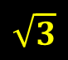
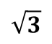
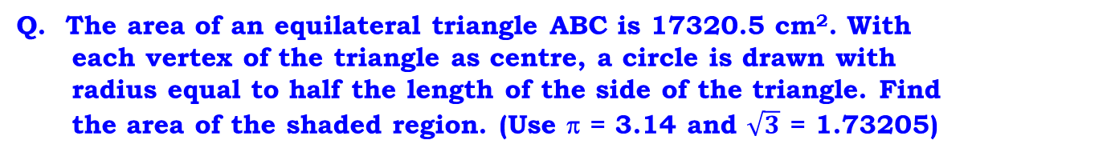

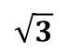



Q. The area of an equilateral triangle ABC is 17320.5 cm². With
each vertex of the triangle as centre, a circle is drawn with
radius equal to half the length of the side of the triangle. Find
the area of the shaded region. (Use π = 3.14 and $\sqrt{3}$ = 1.73205)
ar (shaded region) =
ar (ΔABC)
–
ar (3 sectors)
3 ar (1 sector)
Sol.
ar (ΔABC)
=
17320.5 cm²
A
$$\sqrt{3}$$
ar (ΔABC)
=
$$×$$
(side)²
4
From area, let us find side of the equilateral triangle
∴
$$\sqrt{3}$$
$$\sqrt{3}$$
What is the formula to find area of an equilateral triangle?
$$×$$
(side)²
17320.5
=
4
$$×$$
side²
4
∴
1.73205
=
17320.5
B
C
$$×$$
(side)²
4
173205
173205
(side)²
∴
$$×$$
=
4 × 100000
4 × 10

Slide 19

Q. The area of an equilateral triangle ABC is 17320.5 cm². With
each vertex of the triangle as centre, a circle is drawn with
radius equal to half the length of the side of the triangle. Find
the area of the shaded region. (Use π = 3.14 and $\sqrt{3}$ = 1.73205)
✓
ar (shaded region) =
ar (ΔABC)
–
3 ar (1 sector)
Sol.
A
173205
173205
(side)²
∴
$$×$$
=
4 × 100000
4 × 10
173205 × 4 × 100000
∴
(side)²
=
10 × 173205
=
4 × 10000
B
C
side
=
2 × 100
∴
side
=
200 cm

Slide 20





Q. The area of an equilateral triangle ABC is 17320.5 cm². With
each vertex of the triangle as centre, a circle is drawn with
radius equal to half the length of the side of the triangle. Find
the area of the shaded region. (Use π = 3.14 and $\sqrt{3}$ = 1.73205)
✓
ar (shaded region) =
ar (ΔABC)
–
3 ar (1 sector)
✓
✓
Sol.
1
?
A
Radius (r)
=
× Side
?
2
θ
What is the formula to find area of sector?
1
$$×$$
πr²
=
2
× 200
360
∴
Radius (r)
=
100
Central angle (θ) = 60°
60°
We know that, angle of an equilateral triangle = 60°
B
C
3 ×
θ
$$×$$
πr²
ar (3 sectors) =
360
60
Side = 200 cm
$$×$$
3.14
$$×$$
100
ar (3 sectors)
=
$$×$$
100
3 ×
360

Slide 21






Q. The area of an equilateral triangle ABC is 17320.5 cm². With
each vertex of the triangle as centre, a circle is drawn with
radius equal to half the length of the side of the triangle. Find
the area of the shaded region. (Use π = 3.14 and $\sqrt{3}$ = 1.73205)
✓
✓
ar (shaded region) =
ar (ΔABC)
–
3 ar (1 sector)
Sol.
A
1
1
60
$$×$$
$$×$$
100
ar (3 sectors)
=
3.14
$$×$$
100
3 ×
360
6
2
157
1
$$×$$
314
$$×$$
100
=
$$×$$
100
2
100
=
15700 cm²
B
C

Slide 22
Q. The area of an equilateral triangle ABC is 17320.5 cm². With
each vertex of the triangle as centre, a circle is drawn with
radius equal to half the length of the side of the triangle. Find
the area of the shaded region. (Use π = 3.14 and $\sqrt{3}$ = 1.73205)
✓
✓
ar (shaded region) =
ar (ΔABC)
–
3 ar (1 sector)
Sol.
A
ar (shaded region) =
ar (ΔABC)
–
3 ar (1 sector)
17320.5
=
–
15700
=
1620.5 cm²
B
C
∴
Area of the shaded portion is 1620.5 cm²
3 ar (1 sectors) = 15700 cm²

Slide 23
Module 25

Slide 24
AREAS RELATED
TO CIRCLE
Sum based on finding area of
shaded portion
Notes:
School
24

Slide 25
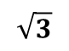
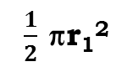
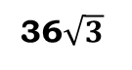
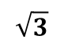
Q. Find the area of the shaded region, where a circular arc of
radius 6 cm has been drawn with vertex O of an equilateral
triangle OAB of side 12 cm as centre.
✓
✓
Sol.
?
?
ar(shaded region) =
ar(circle)
+ ar(ΔAOB)
– ar(O – CXD)
O
Area of circle
πr²
=
6 cm
22
×
6
×
6
What is formula to find area of equilateral triangle ?
=
$$\sqrt{3}$$
7
C
D
×
(Side)²
113.14
What is formula to find area of circle?
4
792
πr²
X
=
7
∴ Area of circle
=
113.14
cm²
A
B
12 cm
$$\sqrt{3}$$
Area of ΔAOB
=
×
(side)²
4
$$\sqrt{3}$$
3
=
×
12
×
12
4
∴ Area of ΔAOB
=
36$\sqrt{3}$
cm²

Slide 26
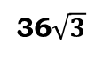
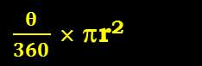
Q. Find the area of the shaded region, where a circular arc of
radius 6 cm has been drawn with vertex O of an equilateral
triangle OAB of side 12 cm as centre.
✓
✓
✓
?
Sol.
ar(shaded region) =
ar(circle) +
ar(ΔAOB) –
ar(O – CXD)
O
θ
?
ar(O - CXD)
×
πr²
6 cm
=
60º
360
We know that, in equilateral triangle each angle is 60º
60
22
D
What is formula to find area of sector?
$\frac{θ}{360}$ × πr²
=
×
×
6
×
6
C
360
7
6
X
132
ar(circle) =
113.14 cm²
=
cm²
7
ar(ΔAOB) =
A
B
36$\sqrt{3}$
12 cm
∴ ar(O - CXD)
=
18.85
cm²
∴
Area of the shaded portion
Area of circle
+
ar(ΔAOB)
–
ar(O - CXD)
=
113.14
36$\sqrt{3}$
=
+
–
18.85
∴
Area of the shaded portion
36$\sqrt{3}$
=
[
94.29
+
]
cm²
∴
Area of the shaded portion is [94.29 + 36$\sqrt{3 }$] cm²

Slide 27
Thank You

